Slide 1

MAULANA AZAD NATIONAL INSTITUTE OF TECHNOLOGY BHOPAL
DEPARTMENT OF COMPUTER SCIENCE AND ENGINEERING
Session 2023-2024
MINOR PROJECT PRESENTATION
Under the Guidance of
Dr.Vikram Garg

Slide 2
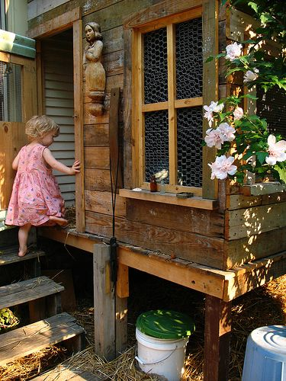
Enhancing accessibility through image captioning and text-to-speech technology
1000268201.jpg, A child in a pink dress is climbing up a set of stairs in an entryway.

Slide 3
GROUP MEMBERS
211112079
211112048
SUHAANI BATRA
211112004
ZANJABILA BANO
211112229
ANKIT KUMAR
AMAN ANAND

Slide 4
TABLE OF CONTENTS
1
INTRODUCTION
5
RESULTS
FUTURE SCOPE
2
LITERATURE REVIEW
6
3
METHODOLOGY
4
TRAINING AND TESTING

Slide 5
01
Introduction
1000268201.jpg, A child in a pink dress is climbing up a set of stairs in an entryway.

Slide 6
Image caption generation has evolved from early methods combining object detection and templating to advanced approaches leveraging deep learning and attention mechanisms. However, current methods often overlook textual information in images, hindering accessibility for the visually impaired.
Our project addresses this gap by developing a multi-modal caption generator, utilizing both visual features extracted by convolutional neural networks and textual information present in images. By providing descriptive audio information about visual scenes, we seek to empower the visually impaired community and enhance their independence.
To achieve this goal, we utilize the Flickr30k dataset, a rich resource comprising diverse images paired with descriptive captions, totalling approximately 155,000 captions. Through data preprocessing steps such as removing duplicated and normalized text, we ensure improved model training and accuracy.

Slide 7
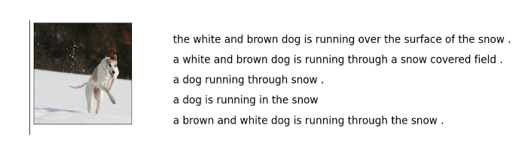
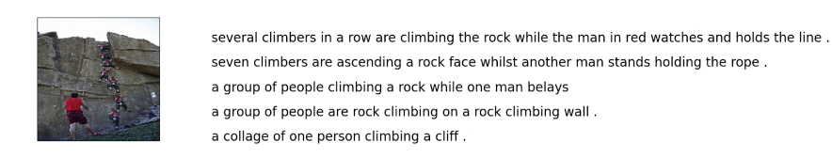

Slide 8
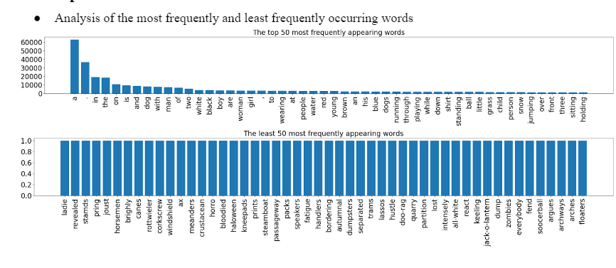
Exploratory Data Analysis
Caption Statistics

Slide 9
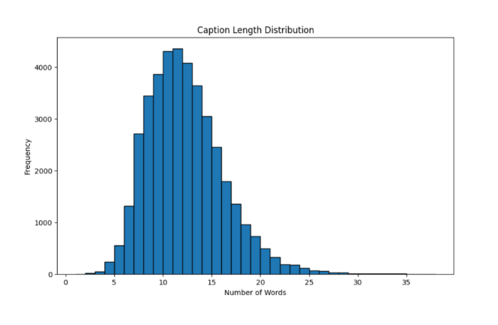
Examination of caption length distribution (number of words per caption).

Slide 10

02
Literature Review

Slide 11
The review explores methodologies like attention mechanisms and transformer-based models, enhancing traditional encoder-decoder performance.
Bahdanau et al. introduced attention mechanisms for sequence-to-sequence modeling, improving translation accuracy by focusing on relevant input parts. "Show, Attend, and Tell" applied attention mechanisms in image captioning, enhancing contextual relevance by dynamically focusing on image regions.
These advancements, including transformer-based approaches, have significantly improved captioning accuracy and inclusivity for visually impaired users.

Slide 12

03
Methodology

Slide 13
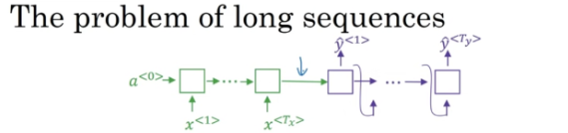
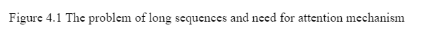
Concept of Attention and Attention Mechanisms
Attention, linked to engagement, is crucial for prioritizing information storage
in the limited capacity of the human brain. Visual attention, extensively studied in neuroscience and psychology plays a pivotal role in this process. By dynamically selecting
and storing information based on relevance, attention ensures efficient resource utilization in memory tasks.
Need for Attention

Slide 14
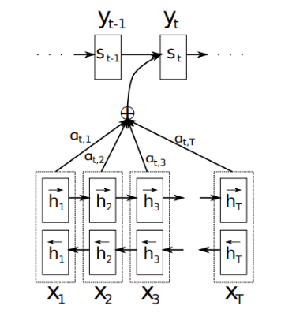
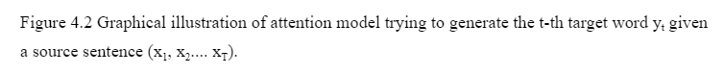
Attention in Machine Learning
Attention in machine learning involves converting raw data into distributed representations and storing them as feature vectors. These vectors form a memory that can be accessed selectively, facilitating sequential tasks without needing to visit all elements. This mechanism optimizes task performance by focusing on relevant information at each step.
In the attention-based system, the input sequence is first processed by an encoder, generating a vector for each element. These vectors, along with the decoder's previous hidden states, are utilized by the attention mechanism to dynamically highlight relevant input information for generating the output. At each step, the attention mechanism computes unnormalized scores indicating alignment between input elements and the current output. Softmax normalization converts these scores into weights, interpreted as probabilities, which are used to scale encoded vectors and generate a context vector. This context vector guides the decoder in generating the translated output, completing the attention process in the system
Attention in Machine Translation

Slide 15
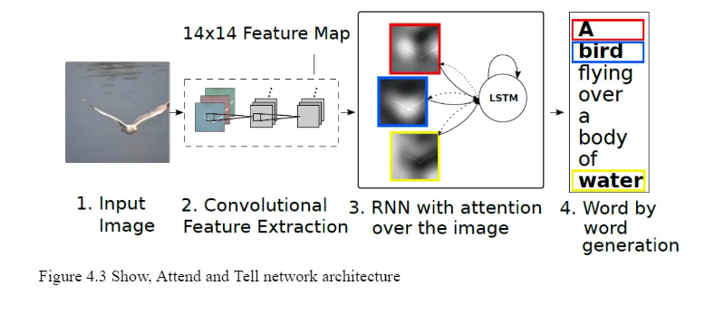
Model Architecture
Attention mechanism - Visual Attention

Slide 16
CNN Encoder
Convolutional Neural Network (CNN) is used for image feature extraction.
Captures hierarchical features from input images.
Employs pre-trained architectures like EfficientNetB0 trained on Imagenet dataset to efficiently extract features.
Enables the model to understand and interpret visual content effectively, enhancing captioning accuracy.
Features are extracted from a lower convolutional layer. This allows the decoder to selectively focus on certain parts of an image by weighting a subset of all the feature vectors.

Slide 17
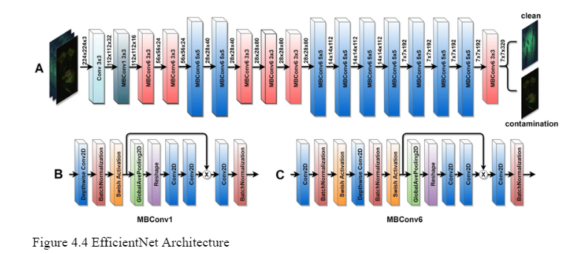
Efficient Net Architecture

Slide 18
Attention Decoder
An LSTM network generates captions by producing one word at each time step, relying on a context vector, previous hidden state, and previously generated words.
The context vector represents the relevant part of the input image.
Each location i is assigned a weight, interpreted as the probability of focus for the next word (stochastic attention) or relative importance for blending (deterministic attention).
Finally, the annotation vectors are aggregated and their weights to compute the context vector.

Slide 19
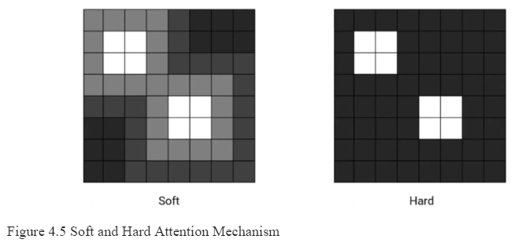
Stochastic “Hard” Attention & Deterministic “Soft” Attention
Deterministic models operate on precise inputs, yielding consistent outputs for a given set of inputs, assuming predictability based on the current state. Conversely, stochastic models introduce randomness and uncertainty, considering the probability of different outcomes.
In image processing, hard attention selectively focuses on specific parts of an image, disregarding others, using probabilistic methods to evaluate relevance.
Soft attention employs weighted features to create a smoother, contextually rich output, allowing each feature to contribute to an overall context vector.

Slide 20
Data Augmentation
The technique of artificially increasing the training set by creating modified copies of a dataset using existing data. Includes making minor changes to the dataset or using deep learning to generate new data points
Augmented Data is driven from original data with some minor changes. Like making geometric or colour space transformations (flipping, resizing, cropping, brightness, contrast) to increase the size and diversity of the training set
Synthetic data is generated artificially using the original dataset using DNNs and GANs.

Slide 21
When to use Data Augmentation?
Limitations of Data Augmentation?
Image Augmentation can do
Biases in the original dataset persist
Quality assurance of data augmentation is expensive
Research and development are
required to build a system with advanced applications
Geometric transformations random flip, crop, rotate, stretch, zoom
Color space transformations - randomly change RGB colour channels, contrast and brightness
Kernel filters - randomly change sharpness or blurring
Random erasing
Mixing images
To prevent models from overfitting
The initial training set is too small
To improve the model's accuracy
To reduce the operational cost of labelling and cleaning the raw dataset

Slide 22

04
Training and Testing

Slide 23
The training phase of an image captioning model is pivotal for its development, dictating its capability to generate accurate captions. Usually conducted over multiple epochs, each epoch represents a complete pass through the dataset. The number of epochs needed depends on factors like model complexity, dataset size, and performance goals. Monitoring metrics like accuracy and loss during training is crucial to gauge the model's learning progress and prediction accuracy.
The accuracy vs. epoch curve tracks the model's accuracy throughout training epochs, showing rapid improvements initially followed by a plateau as the model saturates its learning from the data. Conversely, the loss vs. epoch curve illustrates the model's loss trajectory, decreasing initially before potentially increasing due to overfitting.
Analyzing these curves guides in determining the optimal training duration, ensuring the model achieves high accuracy without overfitting. In our study, we extensively examined these curves to balance performance and generalization, employing techniques like early stopping to enhance the model’s captioning accuracy and diverge images.

Slide 24
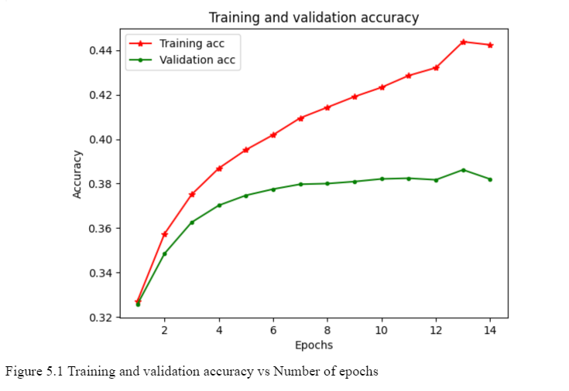
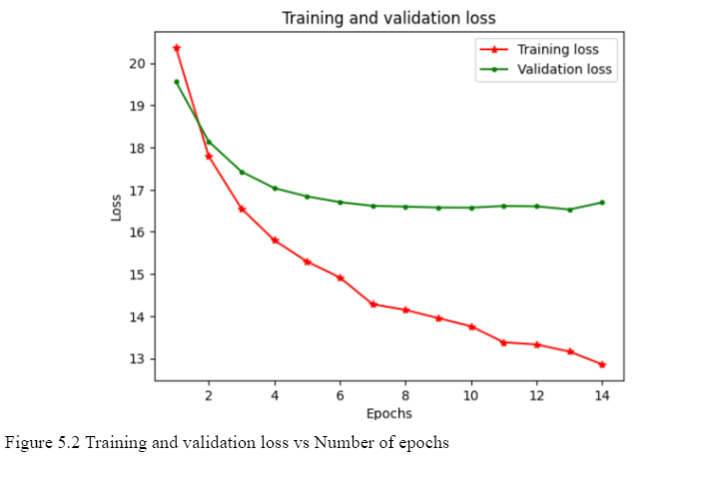

Slide 25
Evaluation Metrics - BLEU Score
The BLEU score, short for Bilingual Evaluation Understudy, is a crucial metric in natural language processing, including image captioning, providing a quantitative measure of text similarity against reference text. It assesses how well the generated caption aligns with reference captions, offering insights into its quality.
Computed automatically, the BLEU score measures how closely the generated caption matches the reference captions, reflecting its ability to capture the image's essence and context effectively. It considers precision measures for unigrams, bigrams, and trigrams, along with a brevity penalty for concise outputs.
As an automated evaluation metric, BLEU acts as a substitute for human evaluators, facilitating objective comparisons between different models and tracking performance improvements over time. It plays a crucial role in guiding refinement and development efforts in natural language processing tasks.

Slide 26
Evaluation Methods:
Greedy Search
Greedy search, a widely used decoding strategy in image captioning, generates captions incrementally by selecting the most likely word at each step based on the model's predictions. It begins with an initial token and iteratively adds the next word to the sequence based on the highest probability from the model's output distribution. This process continues until an end-of-sequence token is generated or a maximum sequence length is reached, ensuring computational efficiency and simplicity in implementation.
Limitations:
Lack of Global optimization
Suboptimal solutions
Greedy search selects each word independently based solely on its local probability, without considering how the entire sequence fits
together. As a result, the generated captions may lack coherence and fail to capture long-range dependencies in the data.
Because greedy search makes locally optimal decisions at each step, it may lead to suboptimal solutions overall. In some cases, the most likely word at each step may not lead to the best overall sequence, resulting in captions that are less fluent or descriptive.

Slide 27
Beam Search
Beam search, an advanced decoding algorithm used in sequence generation tasks like machine translation and image captioning, diverges from greedy search by exploring multiple potential sequences simultaneously. Initially, the algorithm initializes the beam with a single sequence, expanding it at each step to retain the top-k sequences based on their probabilities. The beam width, a critical parameter, influences the quality and diversity of generated captions. While a smaller beam width may expedite decoding, it could yield less diverse and potentially suboptimal captions. Conversely, a larger beam width explores a broader search space, fostering diversity but escalating computational overhead and decoding time.

Slide 28
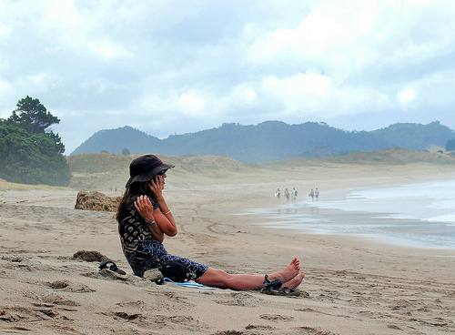
05
Results

Slide 29
Result Analysis
Testing Observations
Testing the image captioning model revealed improved detection of intricate details with adjusted training epochs, partial scene understanding even when the main subject was missed, challenges with rare elements indicating data diversity limitations, occasional inaccuracies in color detection due to insufficient training iterations, and gender misclassification issues highlighting potential biases. The fixed maximum sequence length constrained caption complexity, impacting performance compared to greedy search.
Impact of Training Epochs and Search Strategies:
Training epochs significantly impact the model's accuracy and detail detection in image captioning, with higher epochs improving quality but lower epochs leading to reduced accuracy. Greedy search yields more conservative captions, while beam search explores diverse alternatives but requires longer inference times and more computational resources.

Slide 30
Reference Captions:
1. A woman is sitting on a beach with her shoes off and on a cellphone talking , scratching her shoulder, while a group of 5 other people are walking in the background .
2. A girl in a hat sit on a beach while talking on her cellphone .
3. Woman in hat and talking on cellphone sitting on the beach .
4. A woman sits on the beach while talking on her cellphone .
5. A lady sits in the sand on the beach .

Slide 31
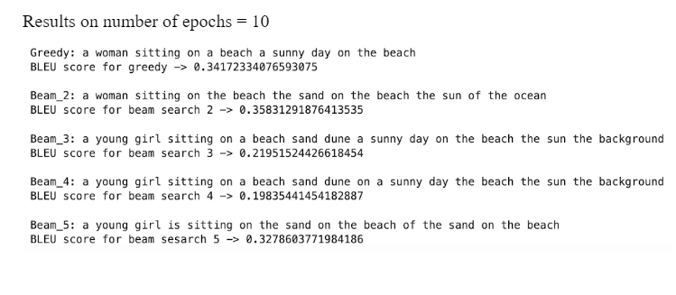
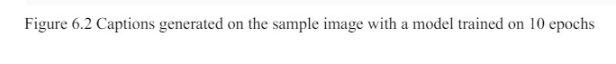
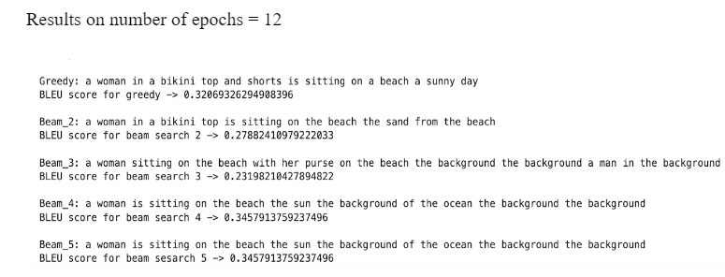

Slide 32
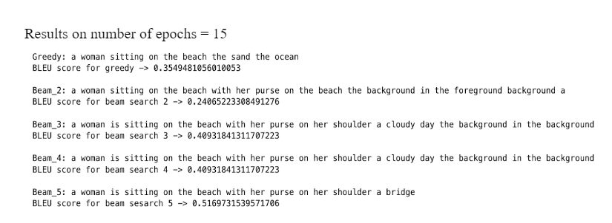
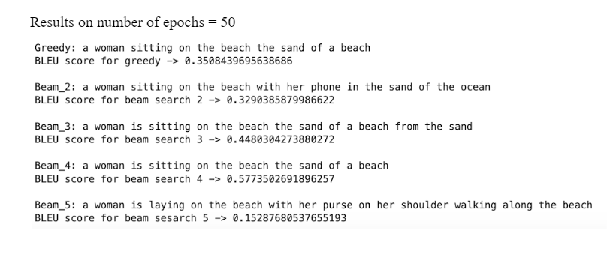

Slide 33
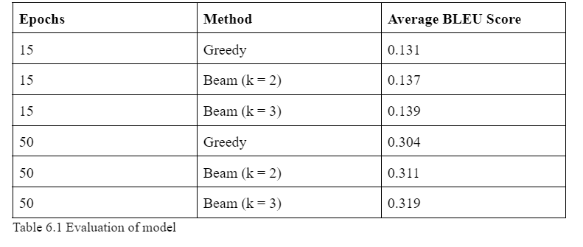

Slide 34

06
FUTURE
SCOPE

Slide 35
Advanced Model Training
Training on larger Datasets
Scaling up training datasets
with diverse images, leveraging
datasets like COCO and Open
Images, for improved robustness.
Refinement of training processes like curriculum learning and self-supervised learning to improve performance and generalization.
Expansion to video Captioning
Extending the model to support
video captioning for capturing
dynamic visual narratives and events.
Accessibility to the Visually Impaired
Ethical Considerations
Evaluating model performance across
diverse demographics and cultures, and
implementing bias mitigation strategies
for fairness and equity.
Integrating the model into assistive
technologies for real-time audio
descriptions, enhancing accessibility
and inclusivity.

Slide 36
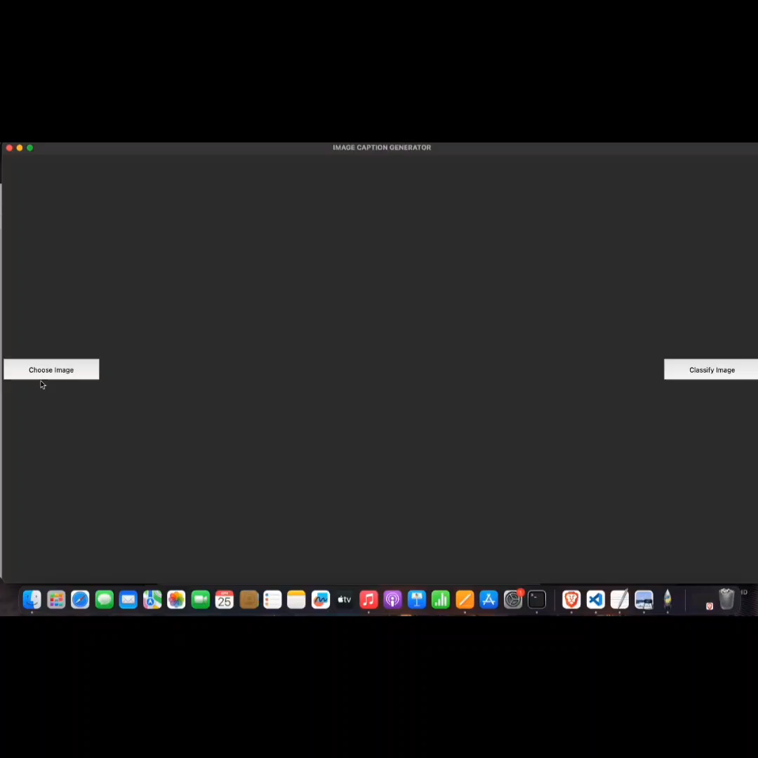

Slide 37
THANK YOU!

